Slide 1

Free Pantry
By Kelly Koury
Here is where your presentation begins

Slide 2
Goals
Provide the community with a place to get free nonperishable food and necessities 24/7. This is accomplished by placing the pantry outside.
We hope this free pantry project will:
- Serve as a model for providing a 24/7 source of free food and supplies to communities in need.
- Promote starting and sustaining more free pantries.
Provide information where people in need can get free food, medical care and shelter.

Slide 3



Where It Started
The grassroots mini-pantry movement was launched in May 2016 in Fayetteville, Arkansas
They planted the Little Free Pantry Pilot, a wooden box on a post outside containing food, personal care and paper items.
The items were to be accessible to everyone all the time no questions.
It is a spin on the Little Free Library concept.
The hope was that it would pique local awareness of food insecurity while creating a space for neighbors to help meet neighborhood food needs.

Slide 4

Why a Free Pantry?
Poverty is a widespread problem which increased during the pandemic.
In 2019 9% or 13,593 City of Alexandria residents lived at or below 100% of the Federal Poverty Level,.
Sometimes people in need do not know where to get help.
The free pantry can provide some additional assistance to Alexandria’s residents that are living in poverty—a place to go when food and other supplies are needed.
The free pantry provides privacy and easy 24/7 access to essentials because it is kept outdoors.
Overall we need more ways to help people get access to free food and basic necessities.

Slide 5
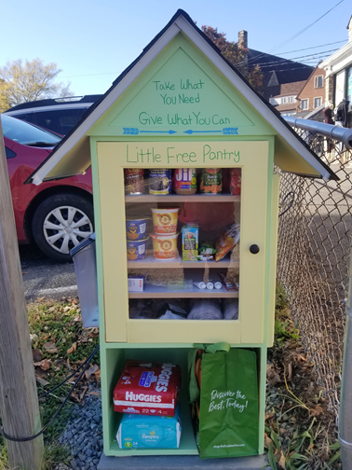
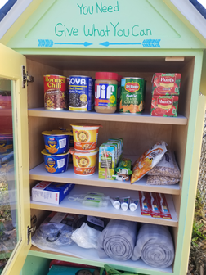

Slide 6
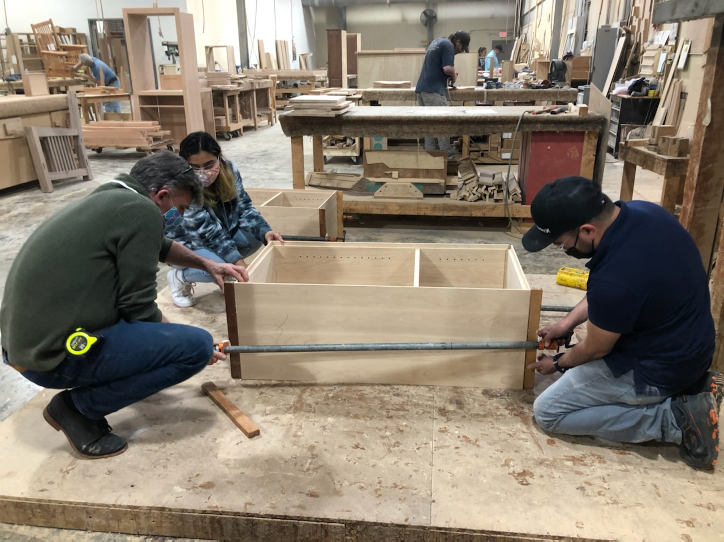
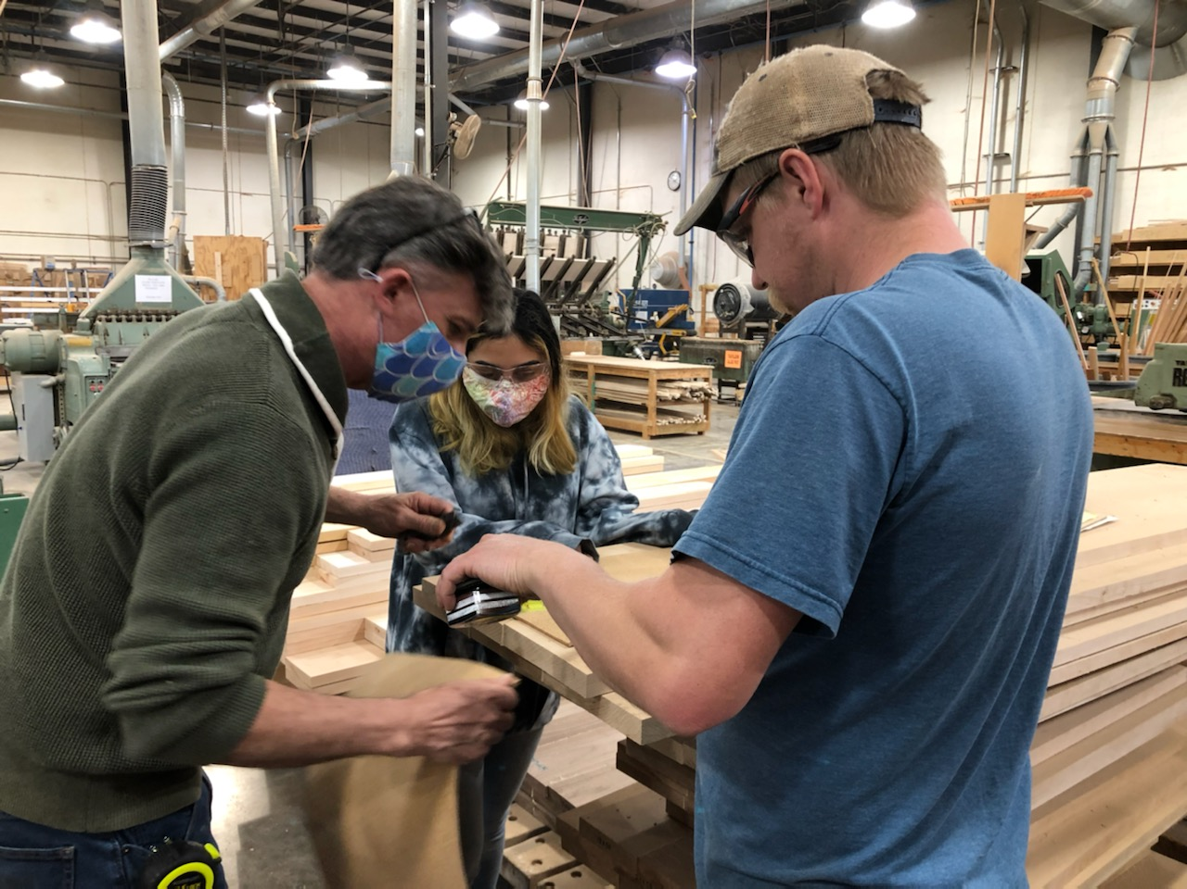
Two Pantries Were Built
The one you just saw and one additional. This was made possible by Mark Gatterdam and others at Hardwood Artisans who so generously volunteered a lot of time and equipment to help me build them.

Slide 7
Where the Pantry is Located and How does it work
The Free Pantry is located at St. Rita’s Church parking lot - Mt. Vernon Ave. (3700 block) .Alexandria VA. It is across the street from AutoZone and The Birchmere.
The pantry opened on October 21, 2021. It has been very active and very well received by the community. Most items in the pantry have been taken within 24-48 hours. In the 80 days since it has been open about 1,500 items have been donated and placed in the pantry. This includes about 450 diapers.
The pantry will be stocked with individual donations from the community.
Donors are asked to bring nonperishable food & supplies to the pantry & place them inside.
There are two ways to donate:
a. Visit our website at https://www.freepantry.org/ to sign up for a day or days to place your donated items in the pantry. The sign up dates run through 12-31-2022.
b. Stop by anytime to place your donated items in the pantry. This is in addition to the signups.
A list of nonperishable food and supplies that are preferred in the pantry by season is posted on the side of the pantry and on the free pantry website. It is in English and Spanish. The list was compiled with the guidance of City of Alexandria staff. Specific suggestions were made to address the needs of the homeless like the use of pop top cans.
"Take what you need. Give what you can.”
A schedule of information on where to get free food, medical care and shelter is available in a holder on the side of the pantry. It is in English and Spanish.

Slide 8
Items to Place in the Pantry by Season
Nonperishable food (in smaller / medium sizes):
Canned food - pop tops preferred ( allowed only in spring and fall )
Beans, chicken, chili, fruit, milk, soup, stew, tomatoes, tuna, vegetables
Other nonperishable food:
a.. Allowed in all seasons - beans in bag,box cereal (single serving) granola bars , juice boxes , mac & cheese , pasta in bag or box , pasta sauce , rice cakes , rice (premade), rice in bag or box , snacks (that won’t melt like Cheez-its, Goldfish,etc.) , water (mini)
b. Fruit cups (pop tops preferred) - allowed only in spring and fall
c. Peanut butter cups or packets , peanut butter in a jar (small/medium) - not allowed in the summer
Supplies -hygiene, personal care (in smaller sizes):
Allowed in all seasons
Bandaids, combs , deodorant, diapers, feminine products, kleenex (individual packets) , lip balm ,
hats, gloves/scarfs , lotion (small) ,masks (disposable) , nail clippers, shampoo (dry) , socks, sunscreen ,
toothbrush , toothpaste, utensils - plastic and wrapped in plastic ,
Allowed in specific seasons
Wipes (baby , small alcohol, small for face) - not allowed in the summer
Sunscreen - preferred only in the summer

Slide 9
Sign on the pantry door - English & Spanish
Little Free Pantry Pequena Despensa Gratis
A Girl Scout Gold Award project Un proyecto de Girl Scout Gold Award
All items in this pantry are free and are Todos los articulos de esta despensa son
available 24/7. gratuitos y estan disponibles las 24 horas
del dia, los 7 dias de la semana.
All items in this pantry are donated by the Todos los articulos de esta despensa son
community. donados por la comunidad.
Donations allowed in the pantry: Donaciones permitidas en la despensa:
Nonperishable food & supplies with an Alimentos y suministros no perecederos
expiration date no less than 4 months. con fecha de caducidad no menor a 4 meses.
Preferred donated items are shown on - Los articulos donados preferidos se
the right side of the pantry. muestran en el lado derecho de la despense.
Canned food is permitted only in the - Los alimentos enlatados solo se permiten en la
spring and fall so as to avoid extreme primavera y el otono para evitar temperaturas
hot or cold temperatures. extremas de calor o frio.
Donated items may be placed in the - Los articulos donados se pueden colocar
pantry anytime. em la despensa en cualquier momento.
NO cash donations or gift certificates NO donaciones en efectivo ni certificados de regalo

Slide 10
List of Where to Get Help in Alexandria
CURRENT LIST - others to be added Source: NVRC Quick Guide
EMERGENCY HELP
Limited short-term aid for basic needs (ex: food, medicine,rent,etc.) Services vary by location.
Alexandria Community & Human Services 2525 Mt. Vernon Avenue 703-746-5901 press 3
ALIVE! Inc. 703-837-9300 press 1
Catholic Charities Christ House 703-548-4227
Salvation Army, Alexandria 703-836-2427
MEDICAL HELP
Inova Alexandria Hospital -4320 Seminary Road 703-504-3000
Neighborhood Health (Alexandria locations - 2 East Glebe Rd and 1200 North Howard St. 703-568-5568
Health Departments - Casey Clinic (1200 Howard St) and King St (4480 King St. ). 703-746-4886 703-746-4996
SHELTERS:
Alexandria Homeless Services Assessment Center - intake for all city shelters 703-746-5700
Alexandria Community Shelter - referral required 703-746-3660
Carpenter’s Shelter - referral required 703-548-7500

Slide 11


Get the Word Out!
Website
Brochure
Visit our website at
https://www. freepantry.org/
The website includes:
  A link to sign up to donate nonperishable food and supplies and deliver them directly to the pantry.
  A list of preferred items in the pantry by season.
  Information about where to get free food, medical care and shelter.
  Information about starting a pantry.
  A video of this presentation
  A survey
Brochure – will be distributed to the Alexandria City community
Placed in neighbor’s mailboxes
Distributed at presentations to civic and neighborhood groups.
Distributed in some retail stores.

Slide 12


Get Involved
SUSTAIN the pantry
1. Please help keep the pantry stocked by signing up for a day or days on our website at https://www.freepantry.org/
to donate items and take them directly to the pantry. Any amount of items will be helpful so it can be filled by individuals/families or groups. We would like to get as many people to sign up to help insure the pantry is viable.
2. You can also take donations any day or time and place them in the pantry. This is in addition to the signups.
3. I am looking for an organization to help sustain the pantry when I go off to college.
This involves maintaining and publicizing the website, checking on the pantry, etc.
START a pantry
1. If you are interested in starting an outdoor free pantry please visit our website https://www.freepantry.org/ for information.
2. I have an additional free pantry to give to someone who would like to start a free pantry that is like the one that is in operation. It is sitting in our garage.

Slide 13
Thank you / Survey
Thank you very much for attending this presentation. Your donations to the pantry and questions about starting a Free Food Pantry in your neighborhood are much appreciated.
I would greatly appreciate if you could fill out the survey about this presentation that is in the free pantry website at https://www.freepantry.org/. It will help me in reporting my project results to Girls Scouts.

Slide 14
Special Thanks
My GS troop 3972 leaders:
Amy Donovan
Jackie Camerlinck
For all their incredible support.

Slide 15



Special Thanks
Reverend Christopher Christensen at St. Rita’s Church, Alexandria for allowing the pantry on church property.
Mark Gatterdam and others at Hardwood Artisans, who volunteered a lot of time and equipment to help me build the pantry.
Michelle Mintling,
City of Alexandria , Dept. of Community & Human Services
who has been my project advisor.
Lucresha Murphy-Tate, City of Alexandria , Dept of Rec., Parks & Cultural who has also been a project advisor.

